Slide 1
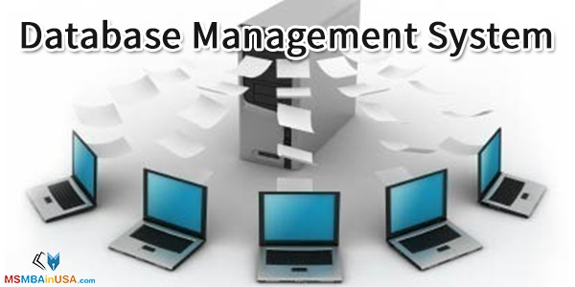

Slide 2
Database
An organized collection of data, stored and accessed electronically.
Database Management System
System software for creating and managing databases.
Provides users and programmers with a systematic way to create, retrieve, update and manage data.

Slide 3

Why DBMS?
Data independency, integrity & security.
Data is very structured.
Persistent and valuable data.
Concurrent access to data.
Backup and recovery services.

Slide 4
DBMS
Can offer both logical and physical data independence
Manages three important things
The Physical database
The database engine
The database scheme

Slide 5


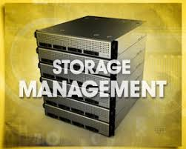


Functions of DBMS
Data Transmission

Slide 6
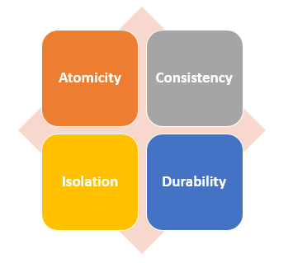
ACID Properties
A set of properties of database transactions intended to guarantee validity even in the event of errors, power failures, etc.
Coined by Andreas Reuter and Theo Harder in 1983.

Slide 7
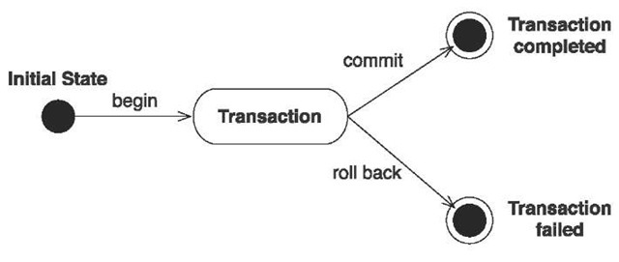
ATOMICITY
Principle of all-or-nothing occurs.
It states a transaction that is either performed as a whole or not performed at all.

Slide 8
CONSISTENCY
Ensures that a transaction can only bring the database from one valid state to another.
This prevents database corruption by an illegal transaction, but does not guarantee that a transaction is correct.
ISOLATION
Ensures that concurrent execution of transactions leaves the database in the same state if the transactions were executed sequentially.
Level of Isolation
Level 0
Level 1
Level 2
Level 3.

Slide 9
DURABILITY
Guarantees that once a transaction has been committed, it will remain committed even in the case of a system failure.
Use of database backups and transaction logs that facilitate the restoration of committed transactions in spite of any subsequent software or hardware failures.
Transaction stays persistent.

Slide 10
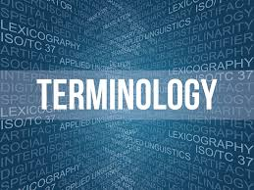
Entity
Attribute
Domain
Tuple
Degree
Cardinality

Slide 11
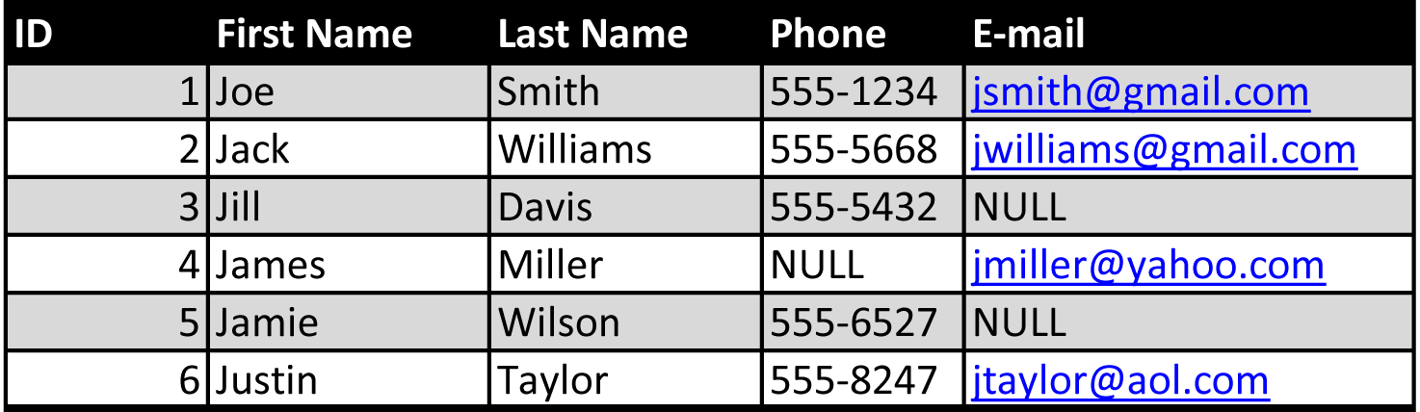

Slide 12
Advantages
Controlling data redundancy
Data sharing & Data consistency
Integration constraints
Control over concurrency
Data Independence

